Slide 1




Complement-mediated HUS
Giovanni Montini
Pediatric Nephrology, Dialysis and Transplantation Unit
Fondazione IRCCS Ca' Granda, Ospedale Maggiore Policlinico
Università degli studi di Milano
giovanni.montini@unimi.it

Slide 2
1. TTP (congenital and acquired)
2. HUS
Shigatoxin-related-HUS (tHUS, D+HUS, VTEC-HUS, eHUS)
Atypical HUS
Complement mediated
Secondary (Malignancies, Autoimmune diseases, Drugs
Infections, Hypertension)
Idiopathic
Coagulation-mediated (DGKe, THBD)
Pneumonia-related
Cobalamine dismetabolism (MMA & deficiency)
3. TA-TMA
4. HELLP
5. APS
6. Scleroderma
7. DIC
The TMAs
Notes:
Thrombotic microangiopathy is a pathologic process, not a single disease, characterized by: Endothelial injury, Microvascular thrombosis, Narrowing/occlusion of small vessels and capillaries
TMA is a final common pathway triggered by different insults
TA-TMA stands for Transplant-Associated Thrombotic Microangiopathy

Slide 3
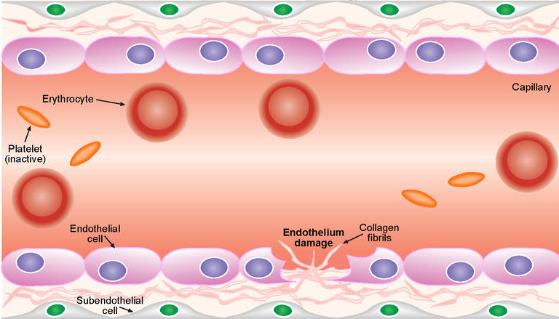
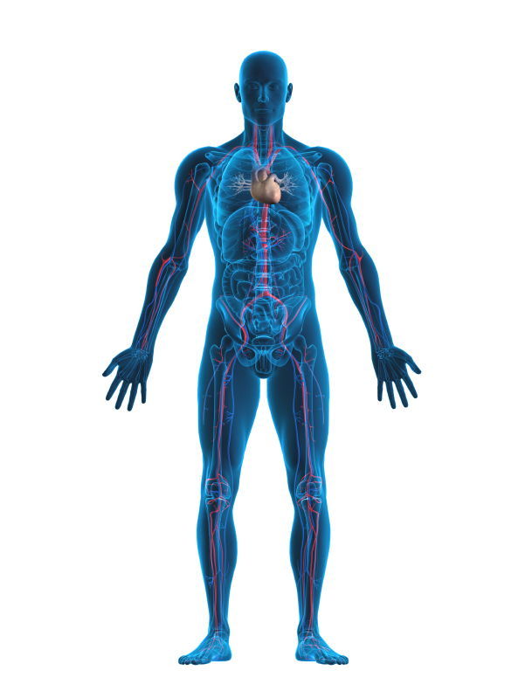
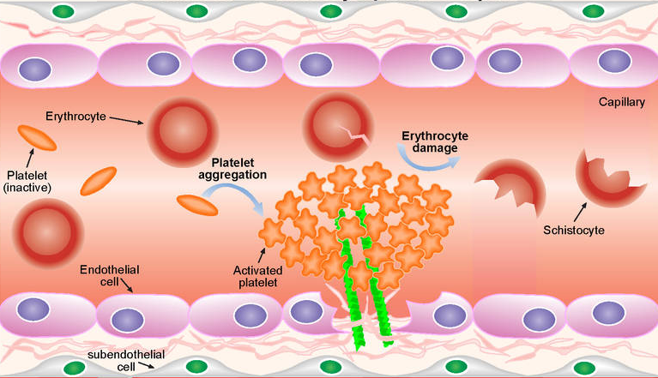
Thrombotic Microangiopathies (MAT): Endothelial Diseases
TA-R, Pneumonia-R,
Coagul-R, Cobalamin-R
Drugs-R, Idiopathic,
Secondary, etc.
Blood
Haemolysis
Decreased platelets
Renal
Proteinuria
Malignant hypertension
Renal failure
Pulmonary
Pulmonary haemorrhage
Pulmonary oedema
CNS
Confusion
Seizures
Stroke
Encephalopathy
Cardiovascular
Myocardial infarction
Thromboembolism
Cardiomyopathy
Gastrointestinal
Liver necrosis
Pancreatitis
IDDM
Colitis
Skin
Ulcerations
Shigatoxin
Complement Abnormalities
Endothelial Damage
Thrombosis in the Microcirculation
Platelet consumption
Hypoxic/
ischemic organ damage
Mechanical hemolysis
Notes:
Thrombotic microangiopathy is a pathologic process, not a single disease, characterized by: Endothelial injury, Microvascular thrombosis, Narrowing/occlusion of small vessels and capillaries
TMA is a final common pathway triggered by different insults

Slide 4

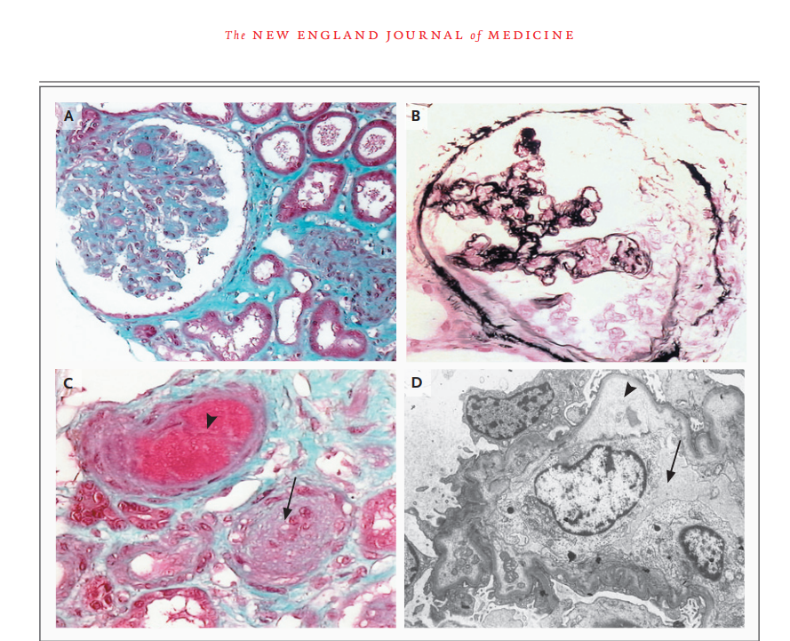
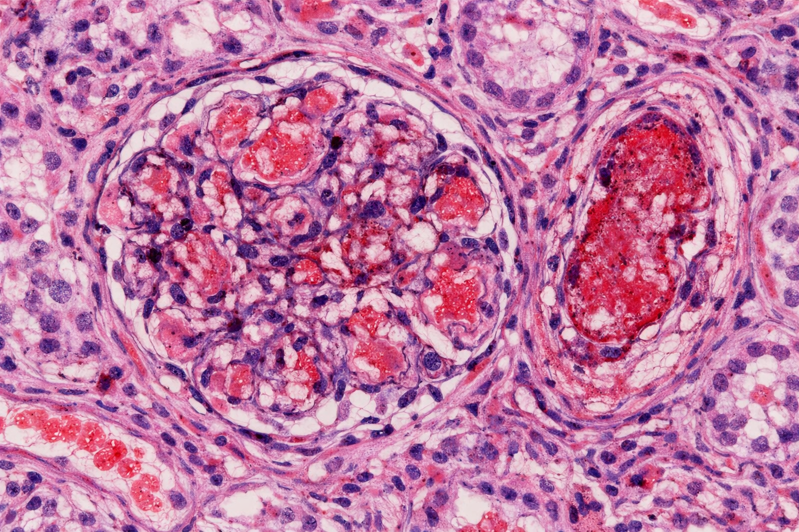
The core histologic pattern: glomerular and arteriolar thrombotic microangiopathy (endothelial swelling, capillary lumen occlusion secondary to platelet fibrin thombi) acute tubular injury, no immune deposition.
Notes:
.

Slide 5
The diagnostic triad
Thrombocytopenia
Hemolytic Anemia
AKI

Slide 6


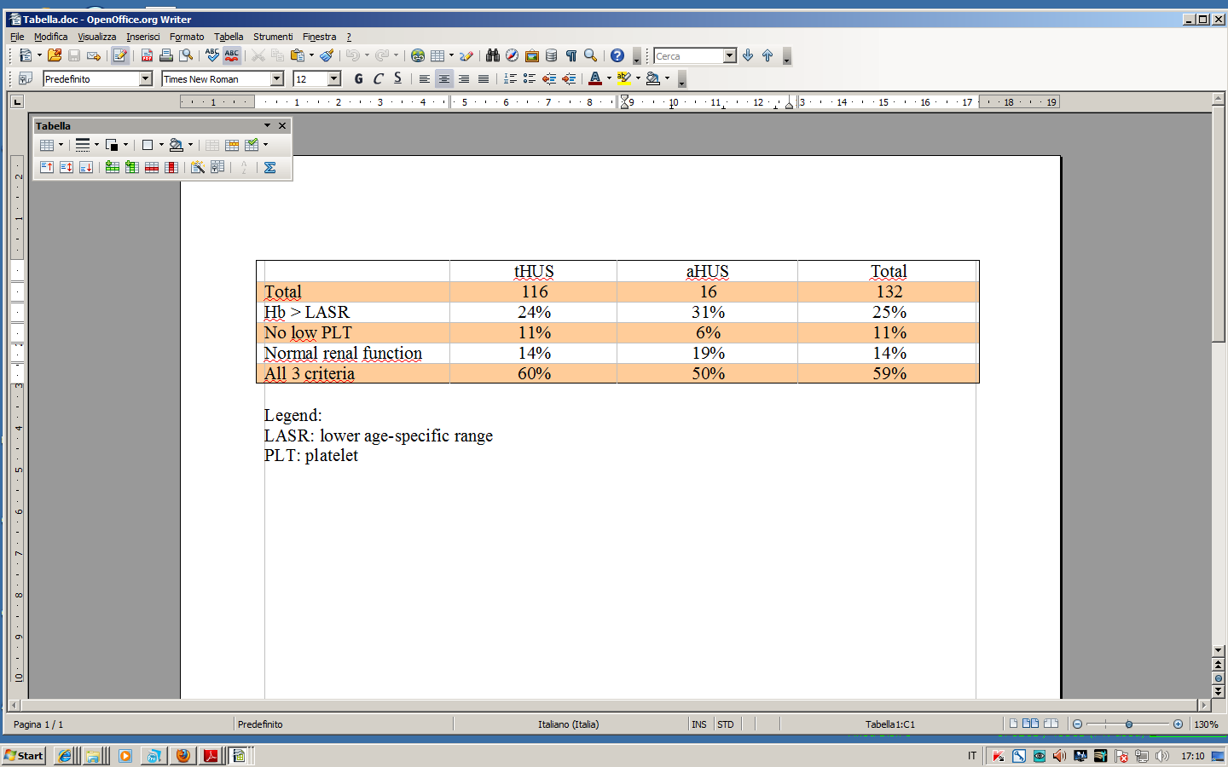
The correct definition of HUS may not be a critical for TMA specialists but the frontline health care providers are not the specialists and the current definition does not help to promptly identify patients
Notes:
LASR: Lowe than age-specific range

Slide 7
The diagnostic triad
Before
Now
Platelet consumption
Thrombocytopenia
Acute reduction in platelet count
IPF >3% o MPV >11 fl
Hemolysis
Anemia
Schistocytes
↑ LDH
Haptoglobin consumption
Kidney Damage
Renal failure
Hematuria/Proteinuria
Thrombocytopenia
Hemolytic Anemia
AKI
Notes:
IPF immature platelet fraction
MPV Mean Platelet Volume

Slide 8
Platelets consumption
Hemolysis
DCT negative
Kidney damage
(+/- multiorgan)
Without diarrhea or with Stx negative diarrhea
Atypical HUS
Rule out TTP (ADAMTS13 >10%)

Slide 9
Epidemiology-based diagnostic algorythm of TMAs
TMAs
CHILD
ADULT
100
100
STX positive diarrhea
85
tHUS
4
1
ADAMTS 13 < 10%
25
TTP
If Pregnant &
Liver enzymes
& No AKI
NA
40
HELLP
14
aHUS
25
HELLP: Hemolysis, eleveted liver enzymes, low platelets
Notes:
HELLP: severe pregnancy-related thrombotic microangiopathy, considered a variant of preeclampsia. HELLP = Hemolysis, Elevated Liver enzymes, Low Platelets

Slide 10
Epidemiology-based diagnostic algorythm of TMAs
CHILD
aHUS
ADULT
14
25
Pneumococcal
pneumoniae
0,6
Pneumoniae-Related
0,2
2
HSCT
8
TA - TMA
Homocysteinemia
0,2
0,8
B12 Dismetabolism
8
Complement dysregulation
8,7
0,2
DGKE mutation
0
0,9
Secondary
4,9
1,5
Idiopathic
3
Notes:
HSCT: Hematopoieti Stem Cell Trnsplantation
High homocysteine is toxic to endothelium and promotes Endothelial dysfunction, Oxidative stress, Platelet activation Procoagulant state
This explains its association with Arterial and venous thrombosis, Premature atherosclerosis, Pregnancy complications, cases of TMA-like endothelial injury

Slide 11
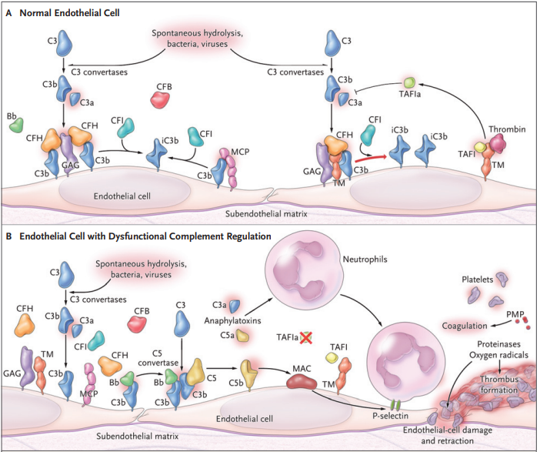
Uncontrolled over-activation of the alternative complement pathway:
1. Genetic abnormalities (50%)
Loss of function
(CFH & CFHR, CFI, MCP)
Gain of function
(C3, CFB)
2. AutoAntibodies (<10%)
(Anti-CFH) associated with CFHR1-R3 deletions
3. Idiopathic (40%)
Trans Membrane protein
on endothelial cells
CFH: Primary brake on C activation
CFHR: Fine tuners proteins
Notes:
MCP stands for Membrane Cofactor Protein. A transmembrane protein expressed on almost all nucleated cells Especially important on endothelial cells Encoded by the CD46 gene on chromosome 1 Its job is to protect host cells from complement-mediated injury

Slide 12
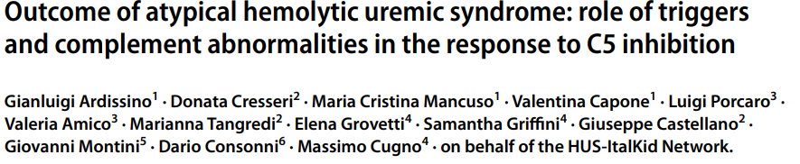
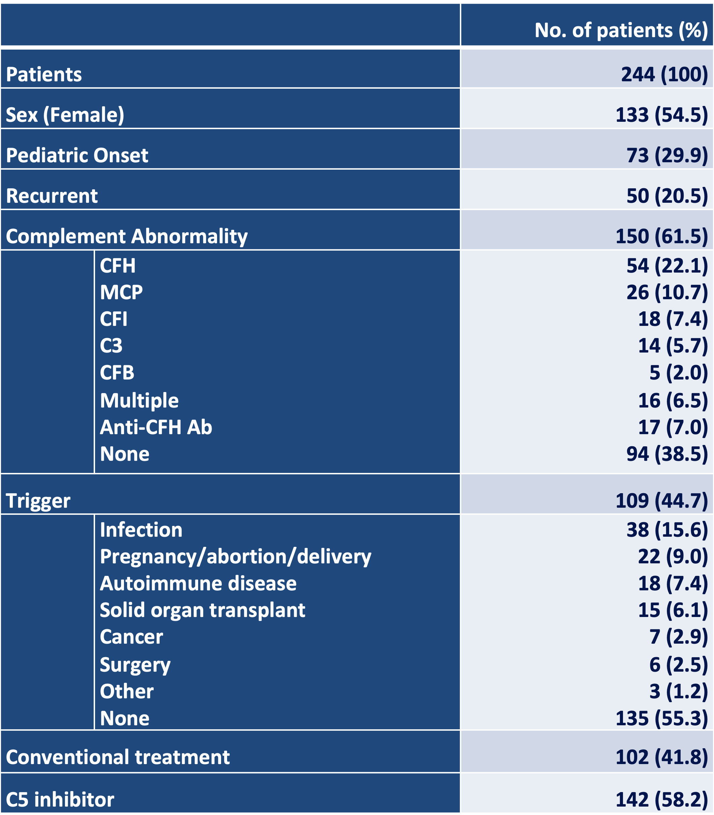
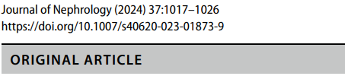

Slide 13
Patients:
(n. 244)
Complement
abnormalities
Complement
abnormalities
%
14.8
8.7
8.3
6.5
2.6
2.6
1.3
55.2
%
22.3
9.9
7.7
6.4
2.1
6.4
6.4
38.8
CFH
MCP
CFI
C3
CFB
Multiple
Anti-CFH AA
None
Sistemic Infection
Delivery
Autoimmune d.
Solid organ tx
Cancer
Surgery
Otherne
None
n. 150
+
+
+
Triggers
n. 109
Triggers
* Trigger: any acute or chronic condition present at the event (HUS ) but not regularly encountered in the general population

Slide 14
Total n: 244 (100%) | Pediatric (n: 73) | Adult (n: 171)
99 (40.6) | 46 (63.0) | 53 (31.0)
49 (20.1) | 14 (19.2) | 35 (20.5)
58 (23.8) | 5 (6.8) | 53 (31.0)
38 (15.6) | 8 (11.0) | 30 (17.5)
Complement
abnormalities
Complement
abnormalities
Primary
+
Combined
+
Secondary
Triggers
Idiopathic

Slide 15
…..which analysis?
Next Generation Sequencing (NGS):
CFH (NM_000186.4)
MCP/CD46 (NM_002389.4)
CFI (NM_000204.5)
C3 (NM_000064.4)
CFB (NM_001710.65)
CFHR1 (da Ex2 a Ex6) (NM_002113.3), CFHR3 (NM_021023.6), CFHR5 (NM_030787.4)
Autosomal dominant
Analytical sensitivity and specificity >98%
Multiplex Ligation-Dependent Probe Amplification Analysis (MLPA):
CFH, CFHR3, -R1, -R2, -R4 e -R5 for the search for macrodeletions/macroduplications and hybrid genes
Sensitivity 90%
+ haplotypes at risk CFH-H3 e MCPgg
Ab anti CFH
Associated with CFHR3-CFHR1 omo deletion
+ THBD (NM_000361.3)
+ DGKE (NM_003647.3) autosomal recessive!!
Notes:
NGS does NOT always detect large structural variants (unless designed to) and some CFHR deletions
MLPA stands for Multiplex Ligation-dependent Probe Amplification. It’s a genetic test used to detect copy-number changes — meaning deletions or duplications of genes or gene segments that standard sequencing (including NGS) can miss

Slide 16
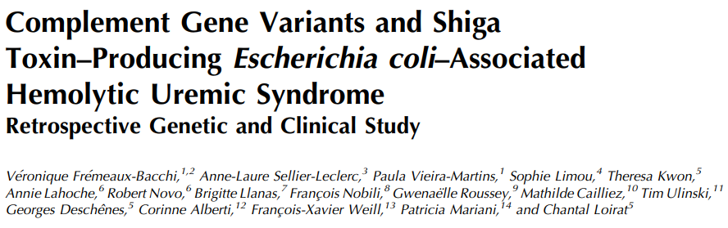
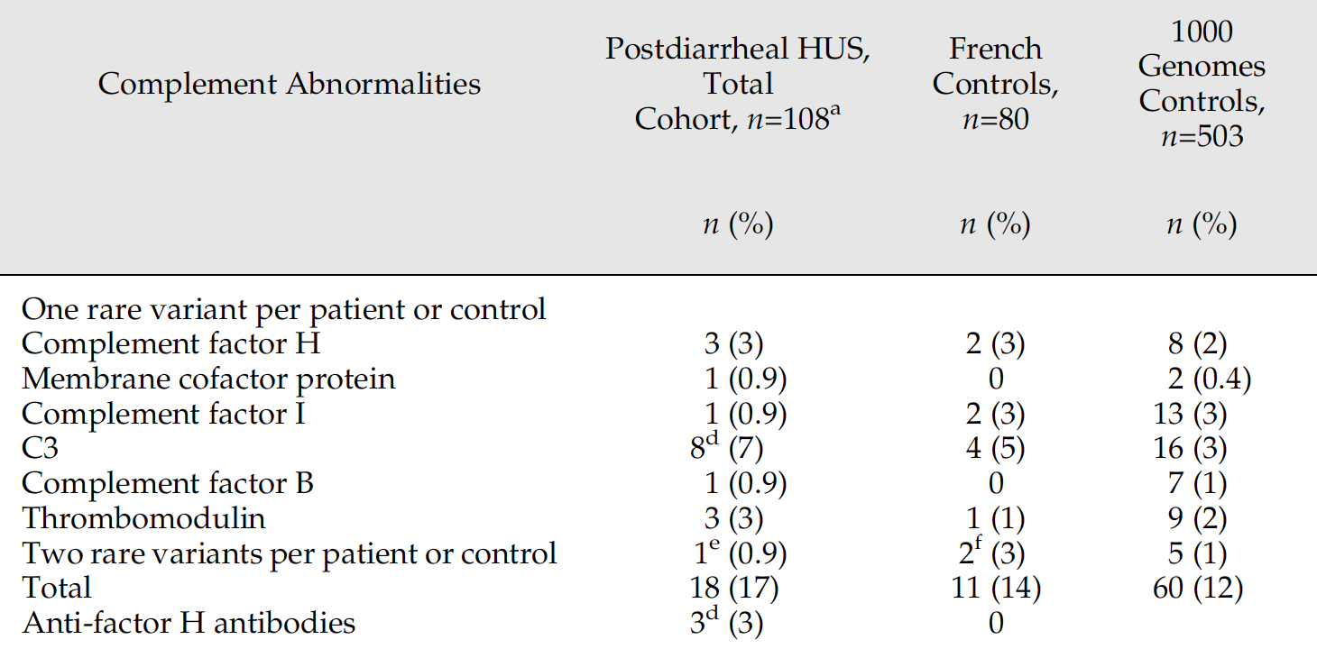

Slide 17
very rare pathogenic variants with minor allele frequency ,0.1% are more frequent in Shiga toxin–positive patients
role of complement activation in Shiga toxin–associated HUS
in rare cases genetic abnormalities may contribute to C activation in Shiga toxin–associated HUS
the only patient who progressed to ESKD carried a factor H pathogenic variant leading to functional factor H deficiency
genetic screening should be considered in post-diarrheal HUS patients who progress rapidly to ESKD.

Slide 18
Differential Diagnosis
 | STEC-HUS | Complement-relatedHUS
Renal Damage | + | +
Haptoglobin | ↓ | ↓
LDH | ↑ | ↑
C3 | ↓/= | ↓/=
PLT | Spontaneous normalization with the overcome of the infection | Normalization only after C5i

Slide 19
SUPPORTIVE TREATMENT
“Ad interim” recommandation for RBC transfusion
When Hb < 7 gr/dL
Target Hb 9-10 gr/dL
“Ad interim” recommandation for Platelets Transfusion
Active bleeding
Significant surgical procedures (Not CVC!)

Slide 20
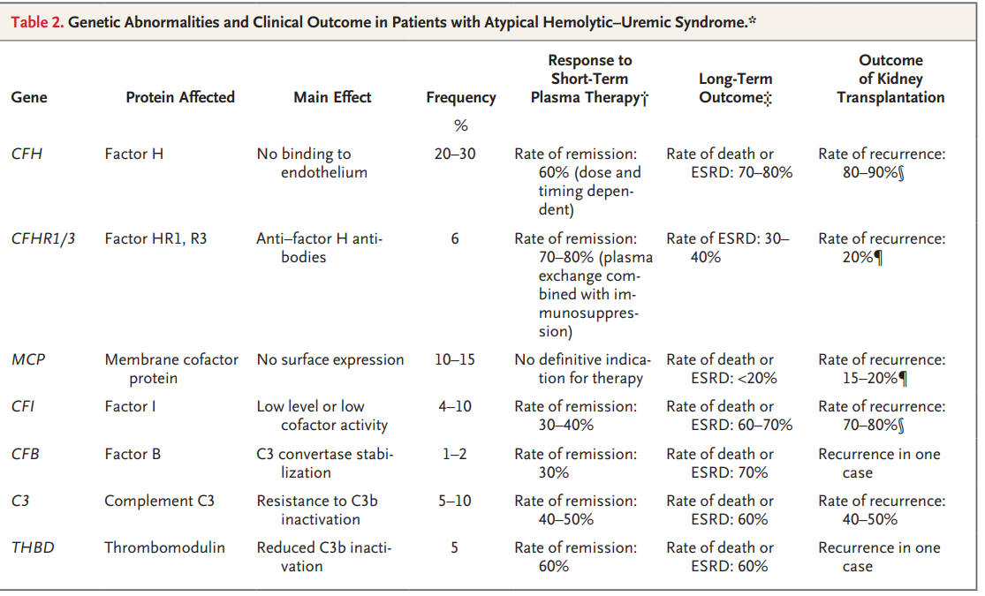

Slide 21

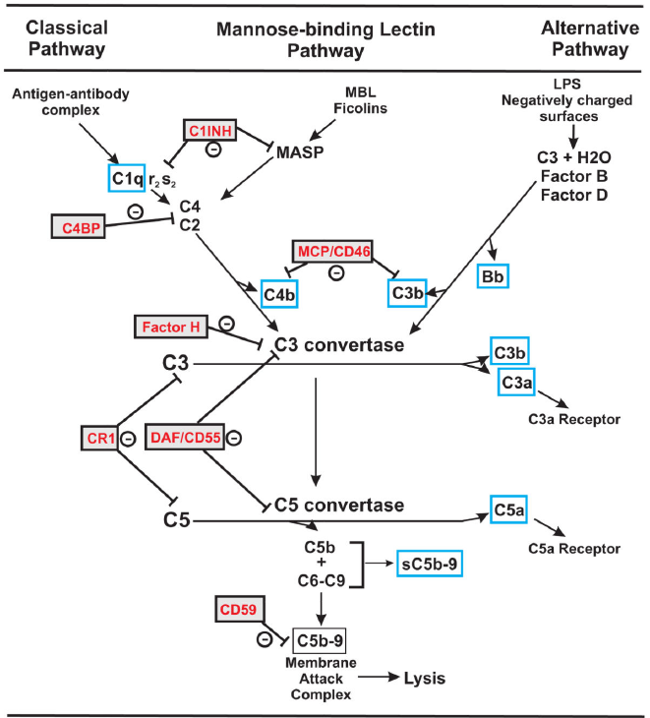

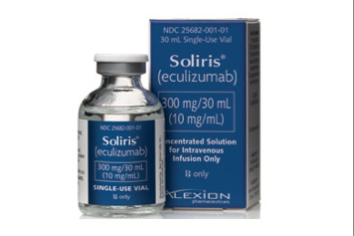
Eculizumab (AntiC5Ab) 2009: the changeover
humanized monoclonal IgG antibody, which targets C5, preventing its cleavage
pediatric eculizumab dosing (aHUS) ≥ 40 kg
Induction: 900 mg IV weekly × 4 weeks
Week 5: 1,200 mg IV
Maintenance: 1,200 mg every 2 weeks

Slide 22
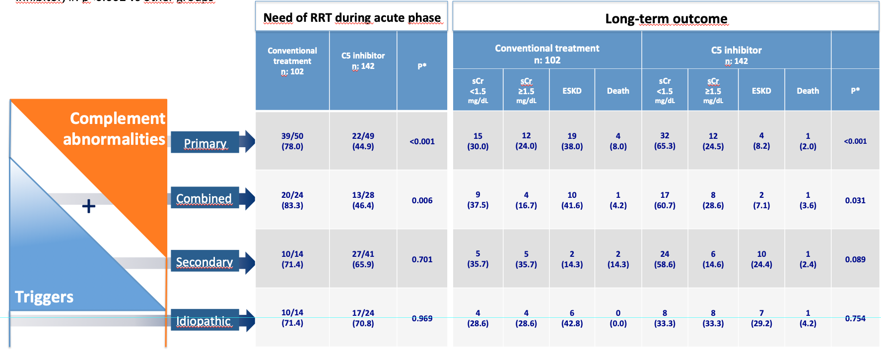
What is the best treatment schedule? Life long???

Slide 23
Discontinuation
RELAPSE RATE
Complement
abnormalities
Complement
abnormalities
18/29
62.1%
PRIMARY
n=95 (38.9%)
COMBINED
n=47 (19.3%)
2/11
18.2%
+
+
SECONDARY
n=54 (22.1%)
0/23
0%
Triggers
IDIOPATHIC
n=37 (15.2%)
0/10
0%
*Triggers defined as an acute or chronic condition that is thought to have contributed to the cause of disease.

Slide 24

the interval between doses was adjusted on classical complement pathway (CCP) activity, targeted to < 30% for the prevention of relapses
38 patients with aHUS (median age:25.0 years)
22 patients receive eculizumab every 28 days and 16 receive it every 21
an inverse correlation between CCP activity and eculizumab circulating levels was present
complement activity measurement can be used as a proxy for circulating levels of the drug
CH50 and dosing interval
150
Classical complement pathway
activity (%)
100
50
0
Baseline
14
21
28
Days from last eculizumab infusion

Slide 25
ALGORITHM
FOR TAILORING ECULIZUMAB TREATMENT
If CH50 is ≤ 2%, the interval between administrations is increased of 1 wk
If CH50 is 3-30%, the interval is confirmed
If CH50 is >30%, the interval is shortened of 1 wk
With the combination of discontinuation and tailored C5i the cost is reduced to 50%

Slide 26
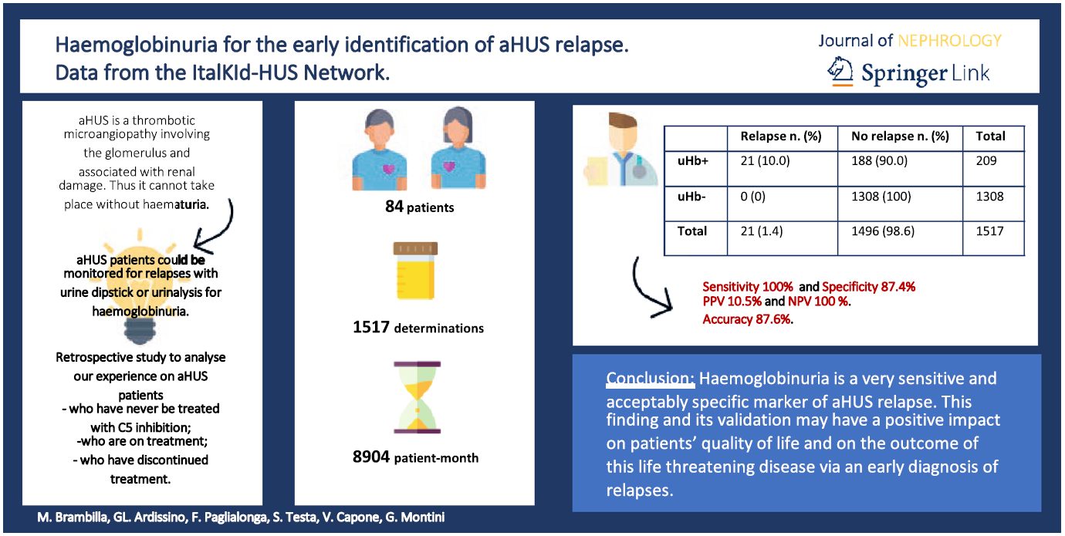
Careful monitoring for disease relapse

Slide 27

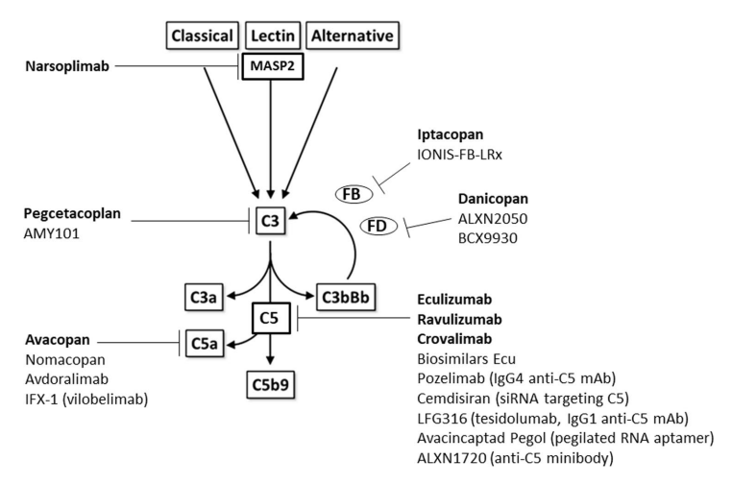
Phase III for relapse-prevention
CFB inibitor
OS daily
Not yet standard in acute aHUS
iv
iv, same target, longer half life, maintenace every 8 w
New kid, sc, every 4 weeks
Notes:
In aHUS, eculizumab isn’t the only game in town anymore.

Slide 28
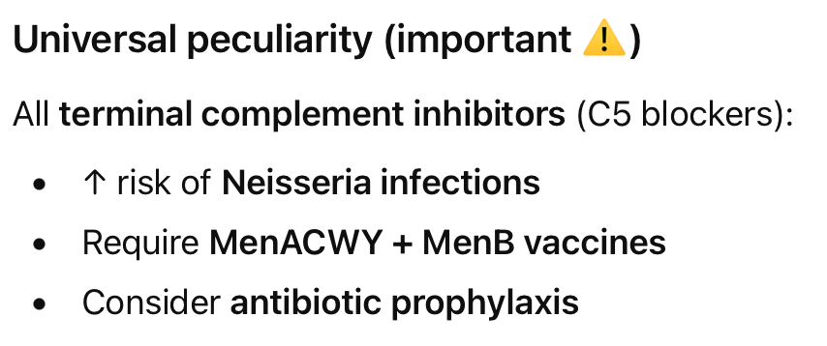
Complement is especially critical for:
Encapsulated bacteria
Neisseria species
Opsonization and immune complex clearance

Slide 29
…………..For decades aHUS has been considered a specific controindication to kidney transplantat for the very high risk of disease recurrence and graft failure

Slide 30
aHUS prognosis in the pre-Eculizumab era
Protein | ESRD (%) | Recurrence on KTx (%)
Factor H | 75 | 90
Factor I | 70 | 75
C3 | 60 | 50
MCP | <20 | 15
For many years, aHUS has been considered an absolute contraindication to KTx due to the high rate of recurrence and graft loss.
Le Quintrec et al. Am J Transplant. 2013;13(3):663-75

Slide 31
Le Quintrec et al. Am J Transplant. 2013;13(3):663-75
Graft survival following aHUS recurrence in patients treated or not with curative plasma therapy
100
PE/PI (n=33)
No PE/PI (n=11)
50
Death-censored graft survival (%)
0
1
5
Time (yrs) from KT

Slide 32
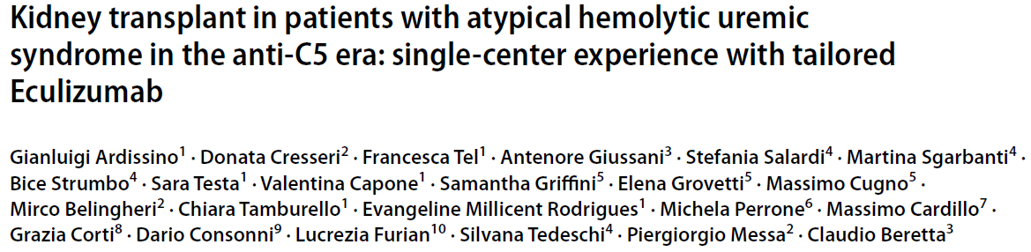
Historical representation of the experience with kidney transplantation in aHUS at Milano HUS Center
N. of pts. 26 (16 F)
N. of KTx: 35
Median time on RRT (yrs) 5.5
Median age at KTx (yrs) 33.5

Slide 33
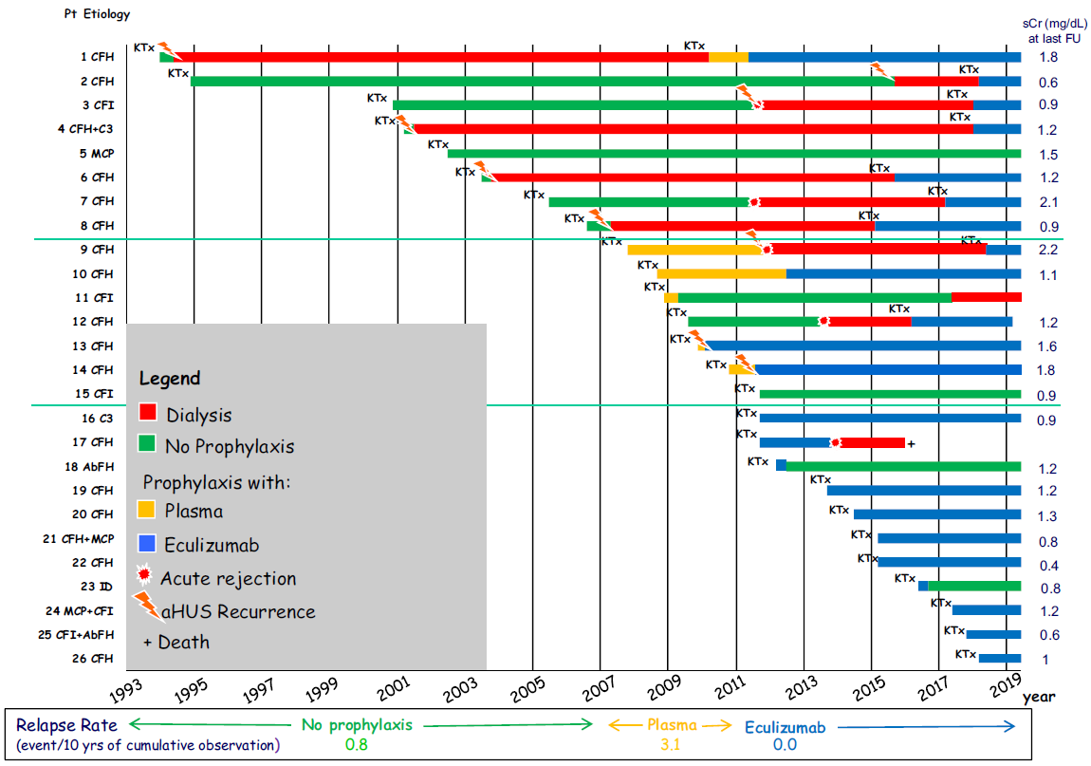

Slide 34
AHUS PATIENTS' MANAGEMENT AIMED AT KTX: OUR EXPERIENCE
Ardissino G et al Pediatr Nephrol 2018;33:457–461
Pre-KTx: - identification and characterization of patients:
NGS for CFH, CFI, CFB, C3, MCP, THBD, DGKe
MLPA for macrodeletions and hybrid genes
Ab anti-CFH research (IgG, IgA and IgM)
- pre-KTx anti-C5 treatment
Peri-KTx: - Confirmation of remission (PLT, haptoglobin, LDH)
- Preoperative eculizumab at a dose appropriate to the patient's weight (adult 900 mg)
- Standard immunosuppressive regimen
P.O.:- Daily monitoring of disease recurrence indicators (PLT, haptoglobin, LDH)
- Subsequent doses of eculizumab based on the genetic abnormality, clinical condition, and evidence of complement suppression (CH50)
In MCP mutation, Ab AntiCFH (levels < 1000 IU/mL ) or idiopathic forms: only pre-KTx administration
Post-KTx: - Maintaining anti-C5 therapy (Ravulizumab or Eculizumab)
- Careful monitoring for recurrence

Slide 35
Take home messages
aHUS is a clinical entity that includes several different diseases that should be actively ruled-in or out
Complement-mediated aHUS has an excellent outcome with C5i but treatment should be started early for a better outcome
Idiopathic aHUS do not respond to C5i
Both Secondary and Idiopathic aHUS do not relapse after discontinuation of C5i
Notes:
.

Slide 36
Take home messages
Urine dip-stick for uHb is very sensitive to identify relapses when patients are off treatment
The interval between doses of C5i can be increased if CH50 activity is regularly monitored
New drugs will be available for the prevention of relapses of complement-mediated aHUS among which FBi seems the most promising

Slide 37
Complement-mediated HUS
Giovanni Montini
Pediatric Nephrology, Dialysis and Transplantation Unit
Fondazione IRCCS Ca' Granda, Ospedale Maggiore Policlinico
Università degli studi di Milano
giovanni.montini@unimi.it

